Slide 1

Corso ISS per l’utilizzo del codice GEANT4 in campo medico
LNS: CATANIA 12-14 Ottobre 2009
PENELOPE EGSnrc/BEAMnrc:
applicazioni in fisica medica
Danilo Aragno Roberta Rauco
UOC Fisica Sanitaria
A.O. San Camillo-Forlanini
Roma
daragno@scamilloforlanini.rm.it
rrauco@scamilloforlanini.rm.it

Slide 2
Overview
INTRODUCTION
EGSnrc/ BEAMnrc
PENELOPE
PHYSICS INTERATION MODEL
APPLICATION in MEDICAL PHYSICS
CONCLUSIONS

Slide 3
INTRODUCTION
Why MC for Medical Phyiscs?
The random nature of the interactions of radiation with matter
A probability distribution function describes each interaction mechanism
“The Monte Carlo technique for the simulation of the transport of electrons and photons through bulk media consists of using knowledge of the probability distributions governing the individual interactions of electrons and photons in materials to simulate the random trajectories of individual particles.
One keeps track of physical quantities of interest for a large number of histories to provide the required information about the average quantities”
TG105 quotes Rogers&Bielajew, 1990, in Dosimetry of Ionizing Radiation V3 http://www.physics.carleton.ca/~drogers/pubs/papers/RB90.pdf

Slide 4
INTRODUCTION
The range of applications is very broad in medical physics
Dose calculation (in phantom or patient)
detectors
sources
radiation protection
radiobiological parameters
...

Slide 5
PUBMED:
Monte Carlo AND dose; Monte Carlo AND Radiotherapy
(title and abstract)

Slide 6
% publication relative to MC(Dose) + MC(RT)
on total publication MC
(title and abstract)

Slide 7
General-purpose Monte Carlo codes
Main differences :
(Manuals available from the www)
physics interaction models
electron transport mechanics (class I and II)
tools (geometry, scoring, variance reduction)

Slide 8
GENERAL DESCRIPTION
BEAMnrc/EGSnrc and PENELOPE are general purpose packages for the Monte Carlo simulation of coupled electron and photon transport that employ the Condensed History technique (CH).
Both simulate the coupled transport of electrons and photons in an arbitrary geometry for particles with energies above a few keV (50 eV only qualitative or, at most, semi-quantitave, more realistic 1keV) up to several hundreds of GeV (50 GeV) .
BEAMnrc/EGSnrc and PENELOPE Code System have been written in Fortran (Mortran, an extended Fortran language).
In new version BEAMnrc uses a C++ package for geometry and source routines!!

Slide 9
Main features of the EGSnrc Code System
• The radiation transport of electrons or photons can be simulated in any element, compound, or mixture.
The data preparation package, PEGS4, creates data to be used by EGSnrc, using cross section tables for elements 1 through 100.
• Both photons and charged particles are transported in steps of random length rather than in discrete steps.
• The dynamic range of charged particle kinetic energies goes from a few tens of keV up to a few hundred GeV.
• The dynamic range of photon energies lies between 1 keV and several hundred GeV

Slide 10
Main features of the PENELOPE Code System
Implements the most accurate physical models available
Photon interactions and positron annihilation are simulated in a detailed way
Scattering of polarized photon beams (synchrotron)
Elaborate scheme to simulate the transport of high-energy electrons and positrons
The simulation of electron and positron interactions - a mixed procedure -!
(elastic scattering, inelastic scattering and bremsstrahlung emission), in which:
- 'hard' events (i.e. those with deflection angle and/or energy loss larger than pre-selected cutoffs) are simulated in a detailed way,
- 'soft' interactions are calculated from multiple scattering approaches
Electron and positron transport in electric and magnetic fields (in matter)
Subroutine package for simulation in quadric geometries

Slide 11
Main features of the PENELOPE Code System
A characteristic feature of PENELOPE is that the most delicate parts of the simulation are handled internally
electrons, positrons and photons are simulated by calling the same subroutines!!!
Thus, from the users point of view, PENELOPE makes the practical simulation of electrons and positrons as simple as that of photons (although simulating a charged particle may take a longer time).

Slide 12
A brief history of the EGSnrc/BEAMnrc
http://www.irs.inms.nrc.ca/BEAM/beamhome.html
BEAMnrc is a Monte Carlo simulation system for modelling radiotherapy sources which was developed as part of the OMEGA project to develop 3-D treatment planning for radiotherapy (with the University of Wisconsin).
D. W. O. Rogers, B. A. Faddegon, G. X. Ding, C.-M. Ma, J. Wei, and T. R. Mackie.
BEAM: A Monte Carlo code to simulate radiotherapy treatment units. Med. Phys. 22, 1995
I. Kawrakow
Accurate condensed history Monte Carlo simulation of electron transport. I. EGSnrc, the new EGS4 version. Med. Phys. 27, 2000.
I. Kawrakow, E. Mainegra-Hing, and D. W. O. Rogers.
EGSnrcMP: the multi-platform environment for EGSnrc. Technical Report PIRS–877, National Research Council of Canada, Ottawa, Canada, 2003
I. Kawrakow and D. W. O. Rogers.
The EGSnrc Code System: Monte Carlo simulation of electron and photon transport. Technical Report PIRS–701, National Research Council of Canada, Ottawa, Canada, 2009.
D.W.O. Rogers, B.Walters, and I. Kawrakow.
BEAMnrc Users Manual. NRC Report PIRS 509(a) July 2009.

Slide 13
A brief history of the EGSnrc/BEAMnrc
GUI Interface
J. A. Treurniet, B. R. B. Walters, and D. W. O. Rogers.
BEAMnrc, DOSXYZnrc and BEAMDP GUI User’s Manual. NRC Report PIRS 0623, 2004.
DOSXYZnrc e BEAMDP
B. R. B. Walters and I. Kawrakow.
Technical note: Overprediction of dose with default PRESTA-I boundary crossing in DOSXYZnrc and BEAMnrc. Med. Phys., 34:2007.
B. R. B. Walters, I. Kawrakow, and D. W. O. Rogers.
DOSXYZnrc Users Manual. NRC Report PIRS 794, 2005.
C.-M. Ma and D. W. O. Rogers.
BEAMDP Users Manual. NRC Report PIRS 509c, 2004.
C.-M. Ma and D. W. O. Rogers.
BEAMDP as a General-Purpose Utility. NRC Report PIRS 509e, 2004.
I. Kawrakow.
The dose visualization tool dosxyz show. NRC Report PIRS 0624, 1998

Slide 14
The EGSnrc Package (the hearth)
Cavity
Cavrznrc
Cavsphnrc
Dosrznrc
Edknrc
Examin
Flurznrc
Sprrznrc

Slide 15
The BEAMnrc Package
BEAMnrc is a dedicated code for radiotherapy clinical beams MC simulations

Slide 16
BEAM simulation workflow
Pegs4
Beamdp
Dosxyznrc

Slide 17
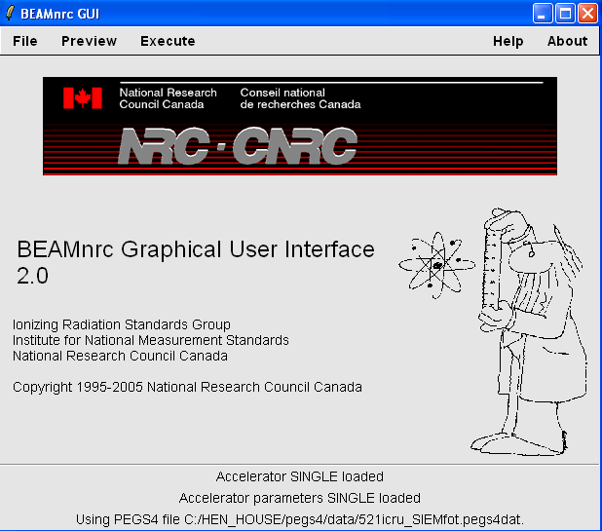

Slide 18
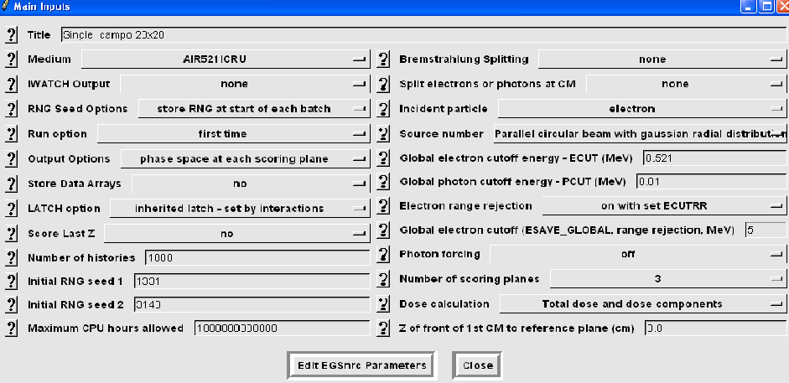

Slide 19
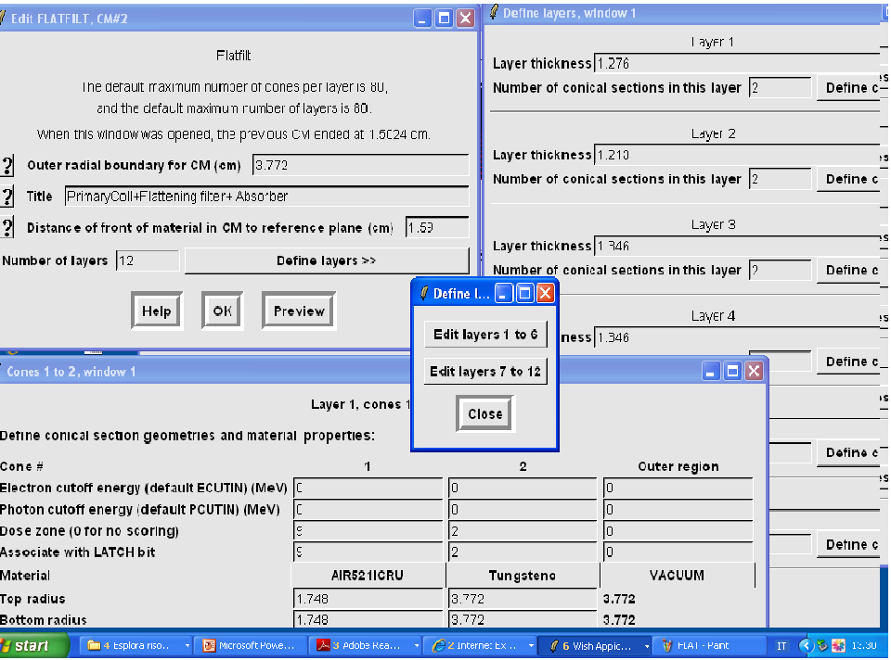

Slide 20
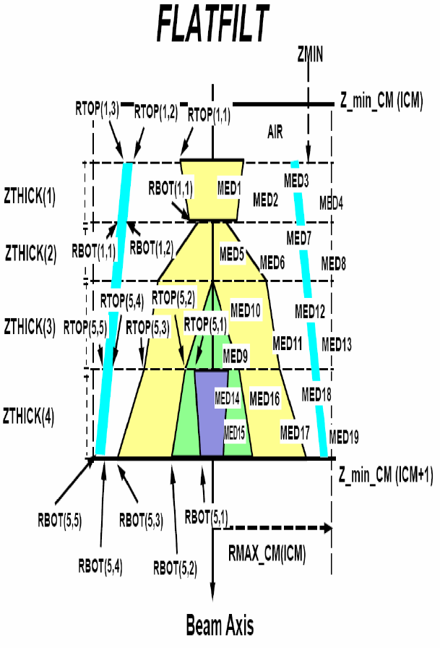
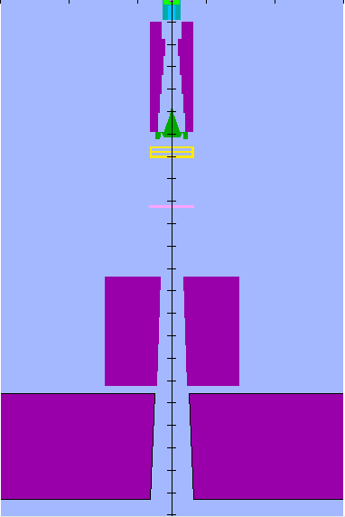
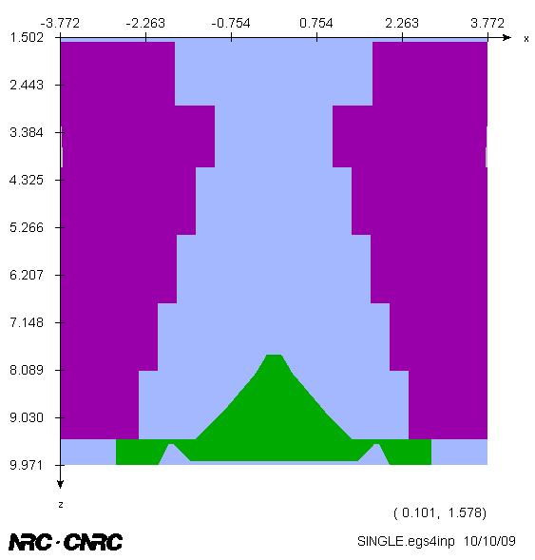

Slide 21
USES OF BEAMnrc
• accelerator design
• study physics of beams
• dosimetry studies
• beam characterization
– 1st step to treatment planning
• commissioning accelerators
• x-ray units
• dose distributions from irradiators

Slide 22
A brief history of the PENELOPE
PENetration and Energy LOss of Positrons and Electrons ... and photons
A general-purpose Monte Carlo simulation code
Distributed by the OECD-NEA Data Bank (Paris)
http://www.nea.fr/lists/penelope.html
Authors: Francesc Salvat, José M. Fernández-Varea, Josep Sempau
Baro J., J. Sempau, J.M. Fernandez-Varea and F. Salvat
PENELOPE: an algorithm for Monte Carlo simulation of the penetration and energy loss of electrons and positrons in matter", Nucl. Instrum. Meth. B 100, 1995
Sempau J., E. Acosta, J. Baro, J.M. Fernandez-Varea and F. Salvat
An algorithm for Monte Carlo simulation of coupled electron-photon transport",
Nucl. Instrum. Meth. B 132, 1997
Sempau J., J.M. Fernandez-Varea, E. Acosta and F. Salvat
Experimental benchmarks of the Monte Carlo code PENELOPE", Nucl. Instrum. Meth. B 207,2003
Salvat F. and J.M. Fernandez-Varea
Overview of physical interaction models for photon and electron transport used in Monte Carlo codes", Metrologia (in press) 2009

Slide 23
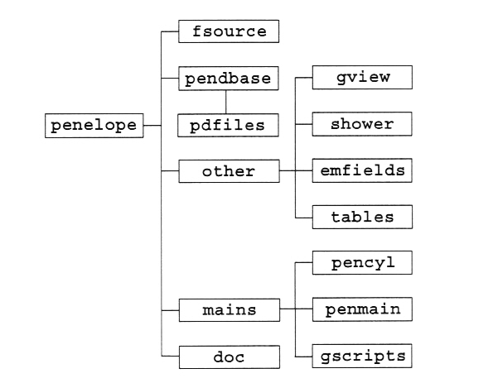
The directory structure of the code system Penelope

Slide 24
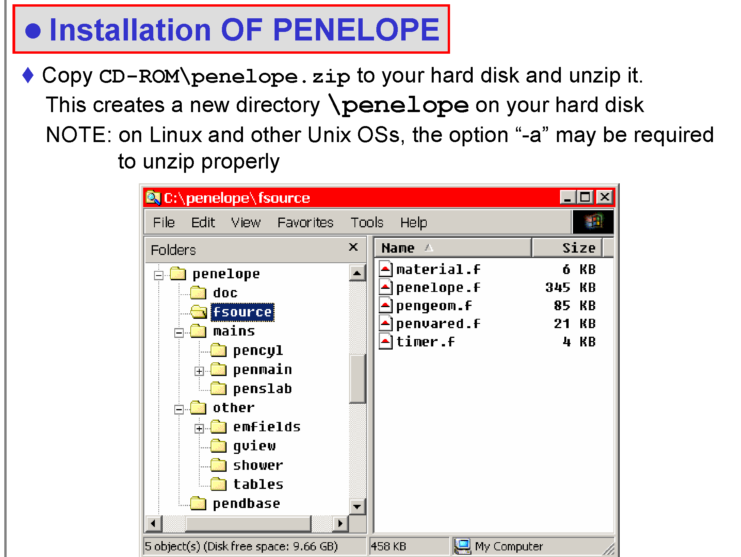
The directory structure of the code system Penelope

Slide 25
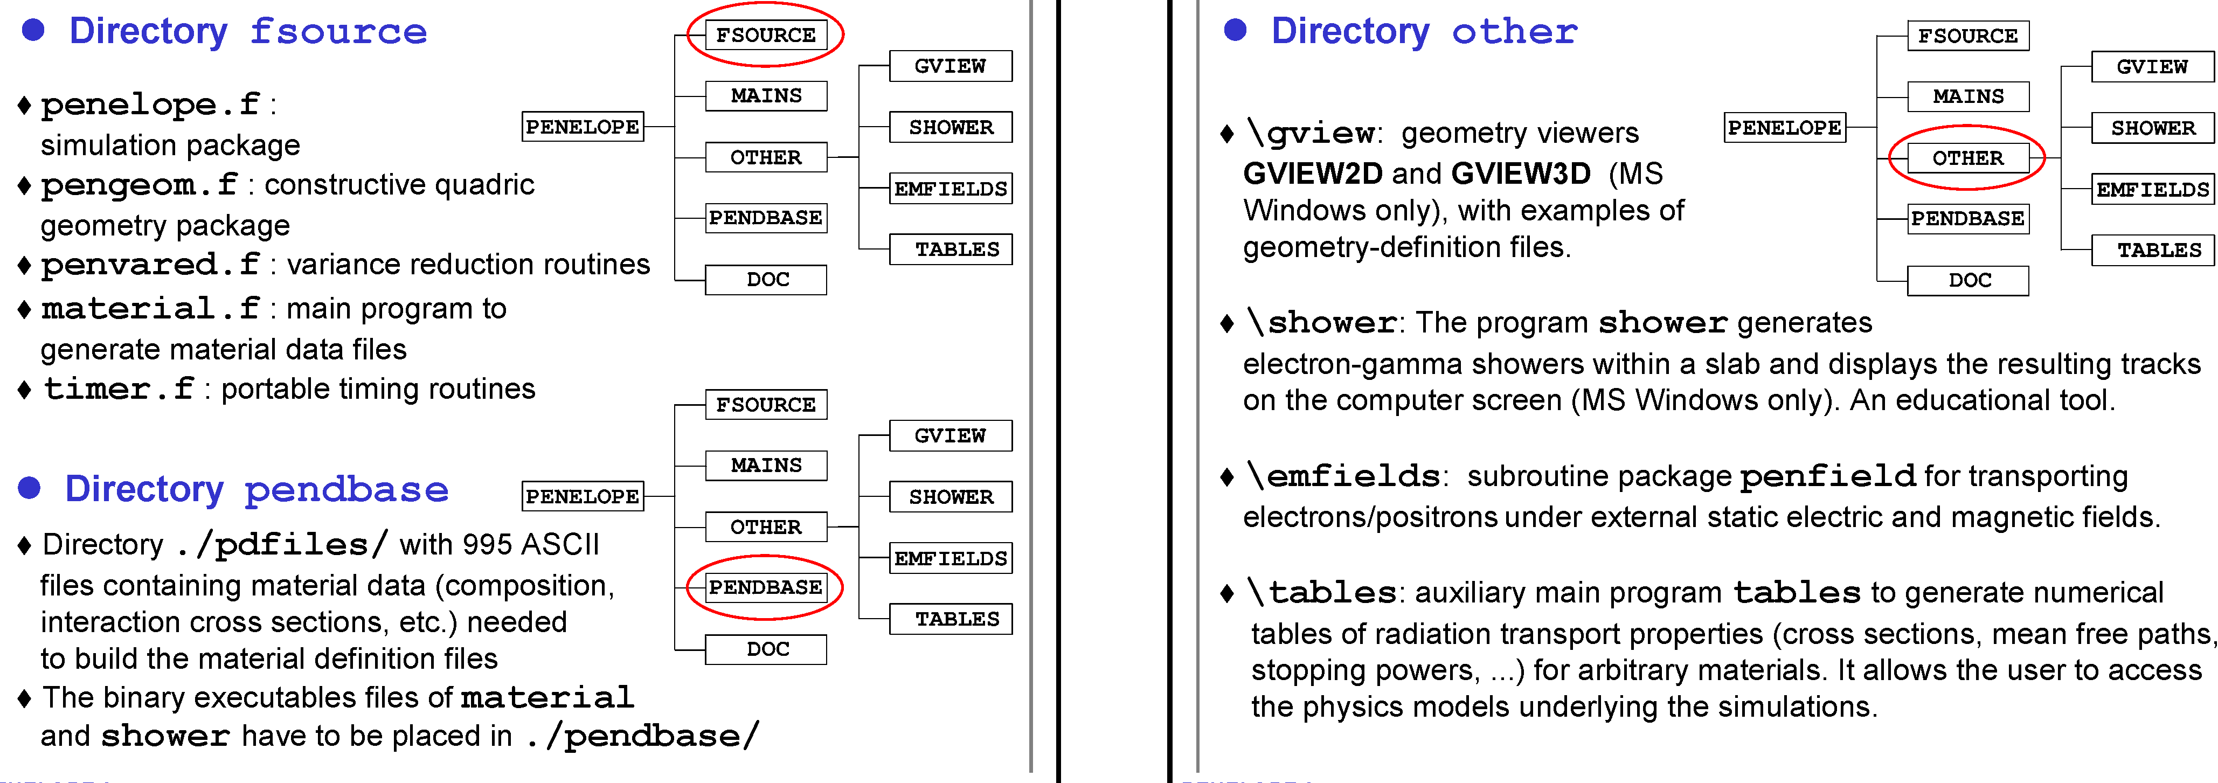
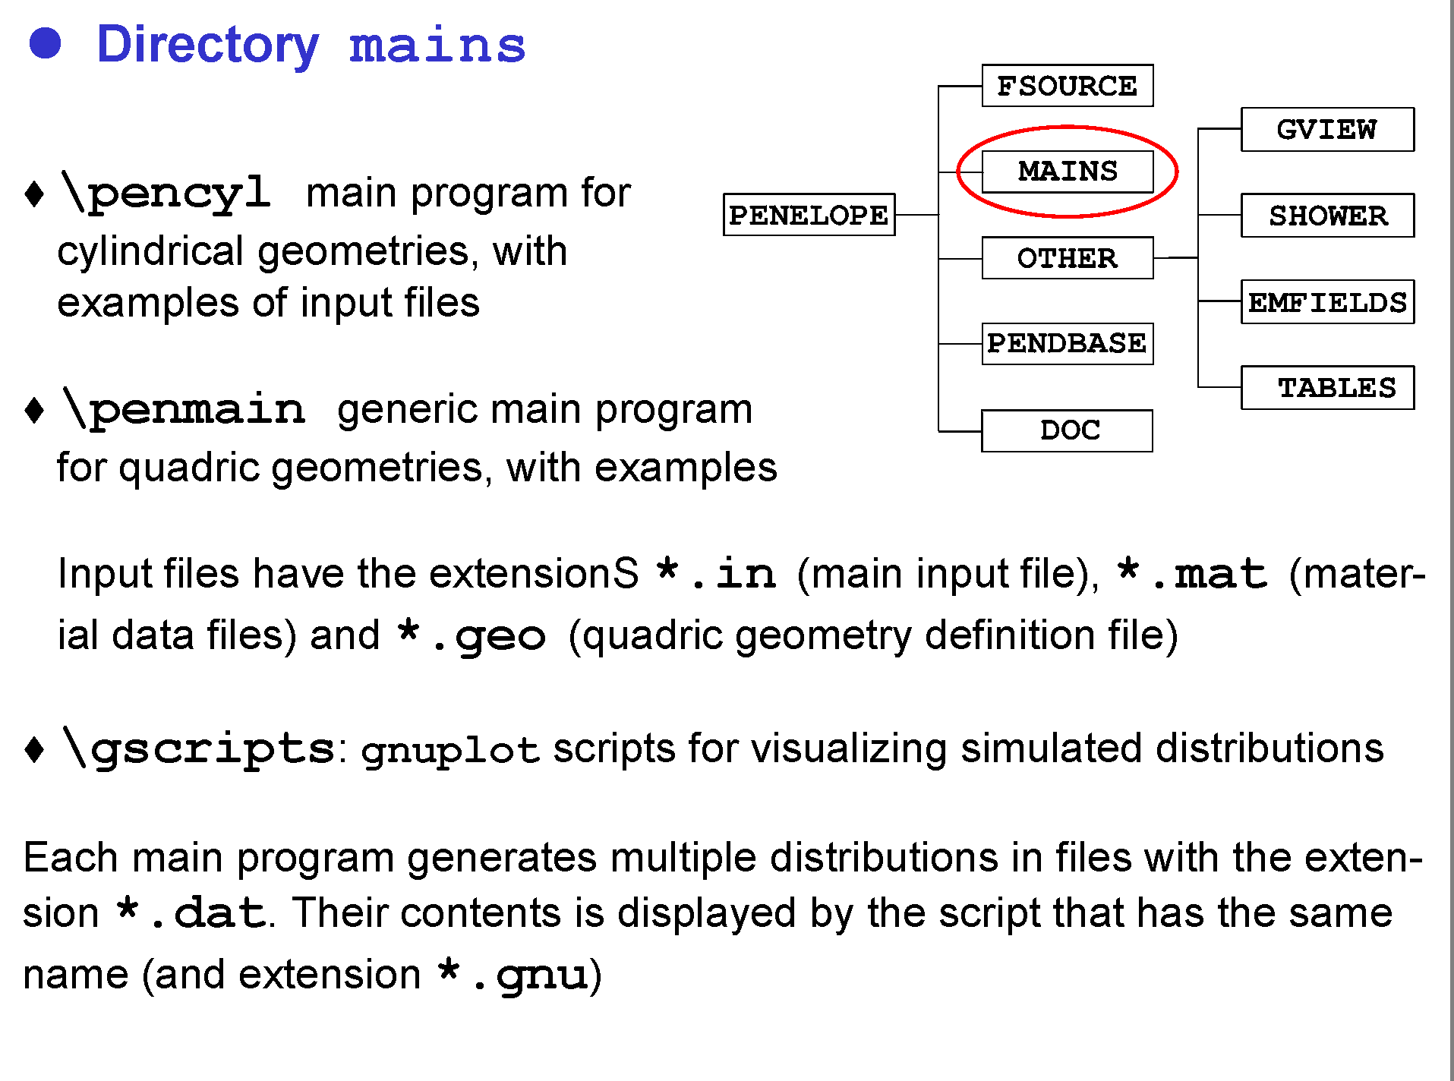
The directory structure of the code system Penelope
Create material data file
280 pre defined materials
100 elements
180 mixtures and compounds

Slide 26
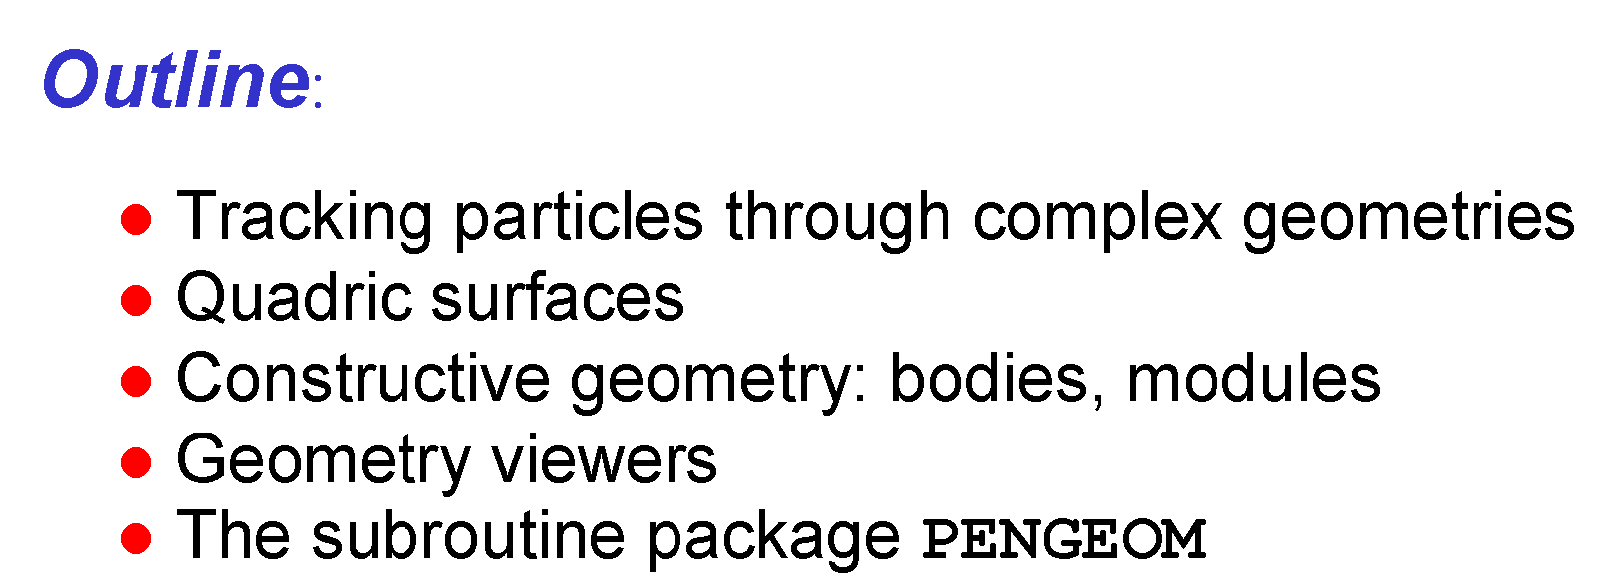
Constructive quadric geometry

Slide 27
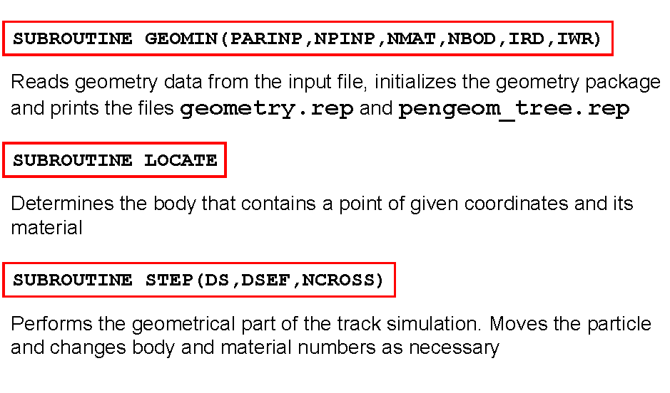
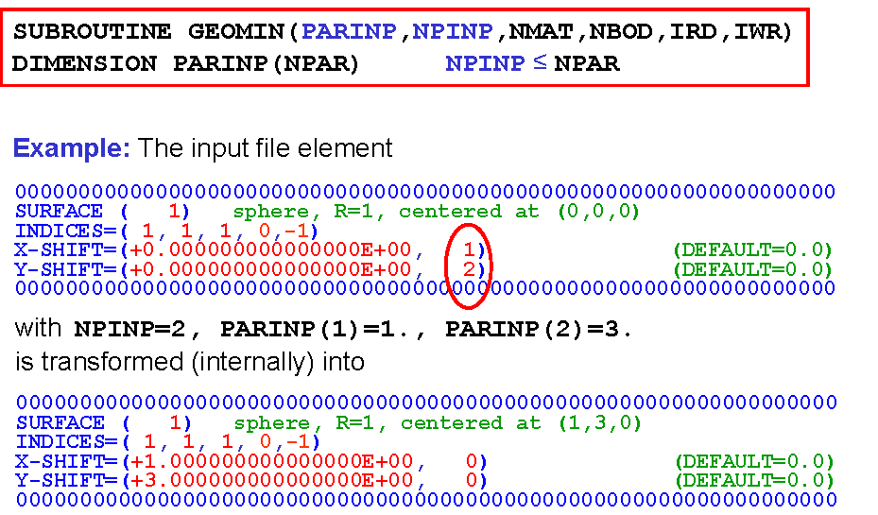
The subroutine package PENGEOM

Slide 28
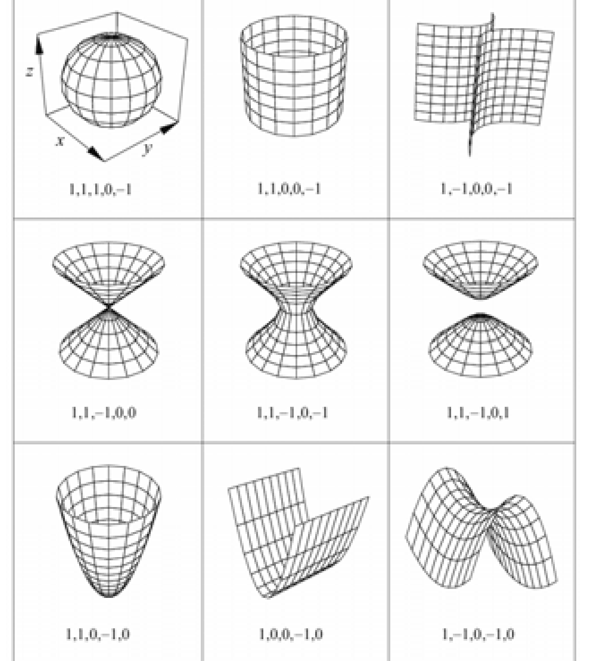
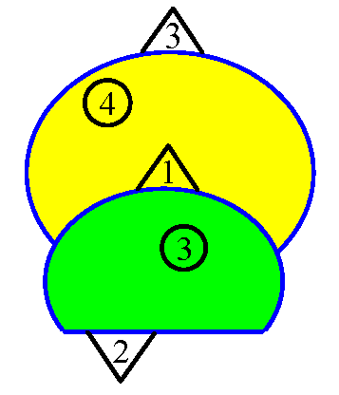
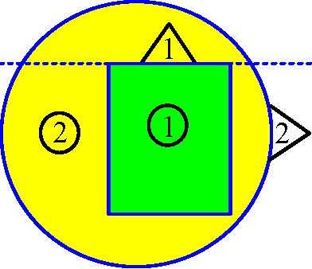
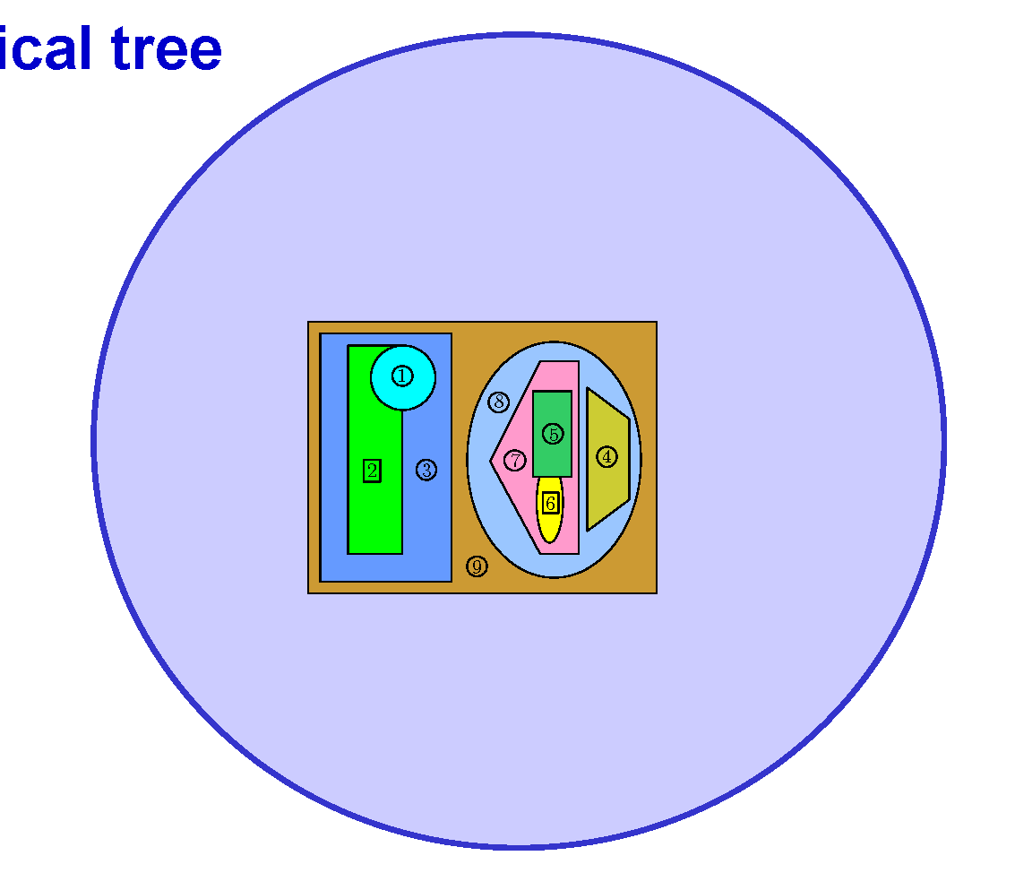
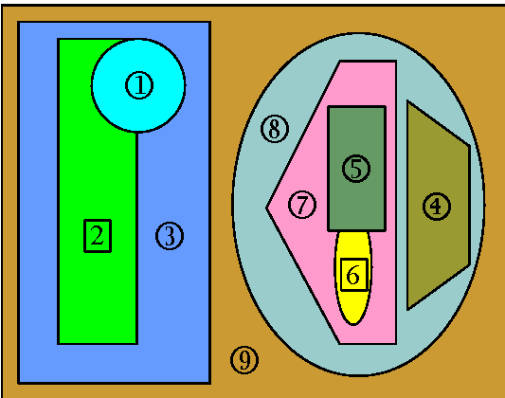
Constructive geometry: bodies and modules

Slide 29
GVIEW3D

Slide 30
PENELOPE is a subroutine package
The user must provide a steering main program for his particular problem.
C ...+....1....+....2....+....3....+....4....+....5....+....6....+....7..
C PROGRAM MAIN
IMPLICIT DOUBLE PRECISION (A-H,O-Z), INTEGER*4 (I-N)
C ************ Main-PENELOPE commons.
COMMON/TRACK/E,X,Y,Z,U,V,W,WGHT,KPAR,IBODY,MAT,ILB(5)
PARAMETER (MAXMAT=10)
COMMON/CSIMPA/EABS(3,MAXMAT),C1(MAXMAT),C2(MAXMAT),WCC(MAXMAT)
1 WCR(MAXMAT)
CHARACTER PMFILE(MAXMAT)*20 ! Material data files
COMMON/RSEED/ISEED1,ISEED2 ! Seeds of the random number generator
C **** Geometry.
DIMENSION PARINP(20),DSMAX(5000),PMFILE(MAXMAT)
cu << Define counter arrays and initialize them to zero
cu Set NTOT (total number of showers to be simulated) >>
C ************ Initialization of PENELOPE.
cu << Set the values of the parameters in the common blocks CSIMPA
cu (simulation parameters) and RSEED (seeds of the random number
cu generator) >>
cu << Define EPMAX (largest energy in the simulation) and NMAT (number
cu of materials in the geometrical structure) >>
PMFILE(1)=’material_1.mat’ ! Material data files (input)
PMFILE(2)=’material_2.mat’ ! etc.
INFO=4 ! Print detailed information on the transport models
OPEN (UNIT=16) ! Output file
CALL PEINIT(EPMAX,NMAT,16,INFO,PMFILE) ! Initializes PENELOPE
CLOSE(UNIT=16)

Slide 31
PHYSICS INTERATION MODEL
Few topics about it

Slide 32
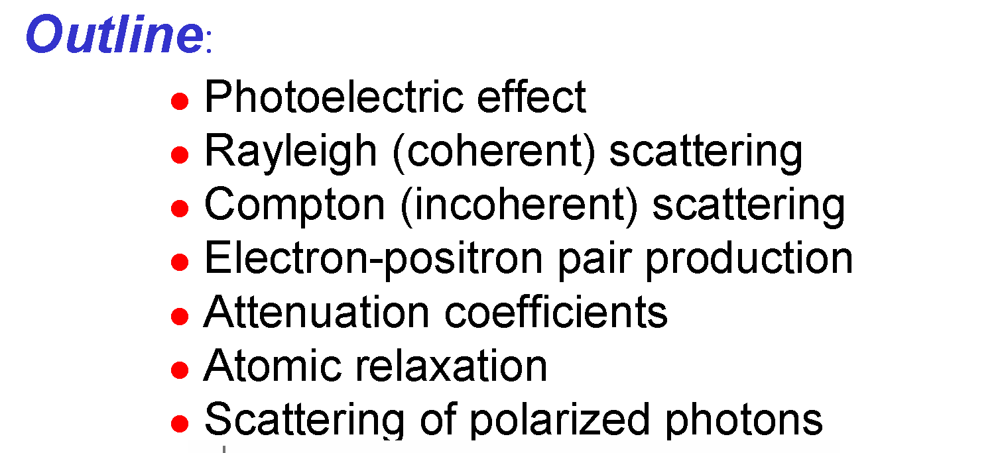
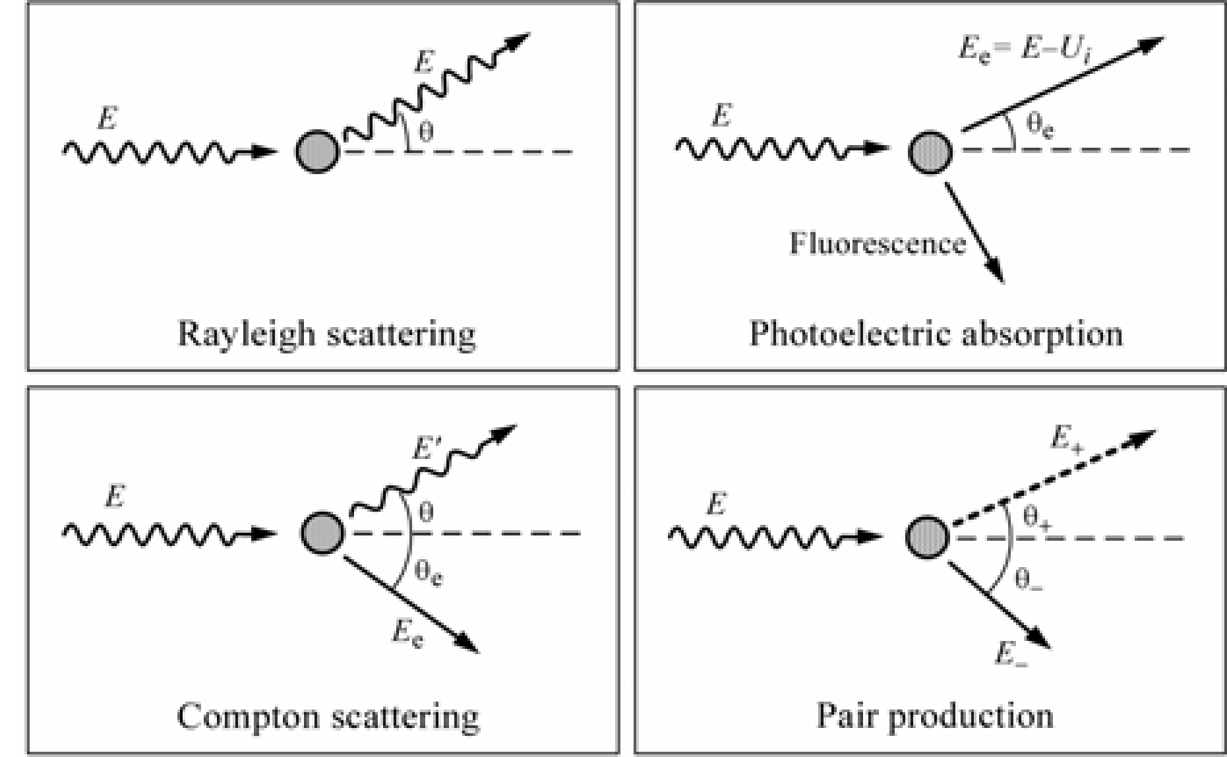
PHYSICS INTERATION MODEL
Photon transport (both)
Not implemented in EGSnrc
Photon transport is simulated by means of the conventional detailed method.

Slide 33
PHYSICS INTERATION MODEL
Electron and positron transport mechanics
Detailed (analogue) simulation, interaction by interaction
+ Nominally exact
− Doable only for low-E, thin media
Class I (condensed) simulation, complete grouping
+ Works for high energies and/or thick media
− Difficulties to describe space displacements and interface crossings
Class II (mixed) simulation
+ Hard events are described “exactly” from their DCSs
+ Elastic, inelastic and bremsstrahlung are “tuned” independently
+ Flexible (from detailed to class I)
− Slow when cutoffs are too small

Slide 34
PHYSICS INTERATION MODEL
Condensed history technique for electron transport
• as electrons slow, they have many interactions
• Berger’s grouping into condensed history steps made Monte Carlo transport of electrons feasible.
– individual scattering events grouped via multiple-scattering theories
– low-energy-loss events grouped into restricted stopping powers
• increases efficiency by decreasing time,T, (a lot)
• modern transport mechanics algorithms are very sophisticated in order to maximize step size while maintaining accuracy (to gain speed).

Slide 35
PHYSICS INTERATION MODEL
Condensed history technique for electron transport
hard collisions create secondaries
(δ-rays / brem)
soft collisions
-grouped
-multiple scatter
-restricted energy loss
condensed history technique: group many individual interactions into steps

Slide 36
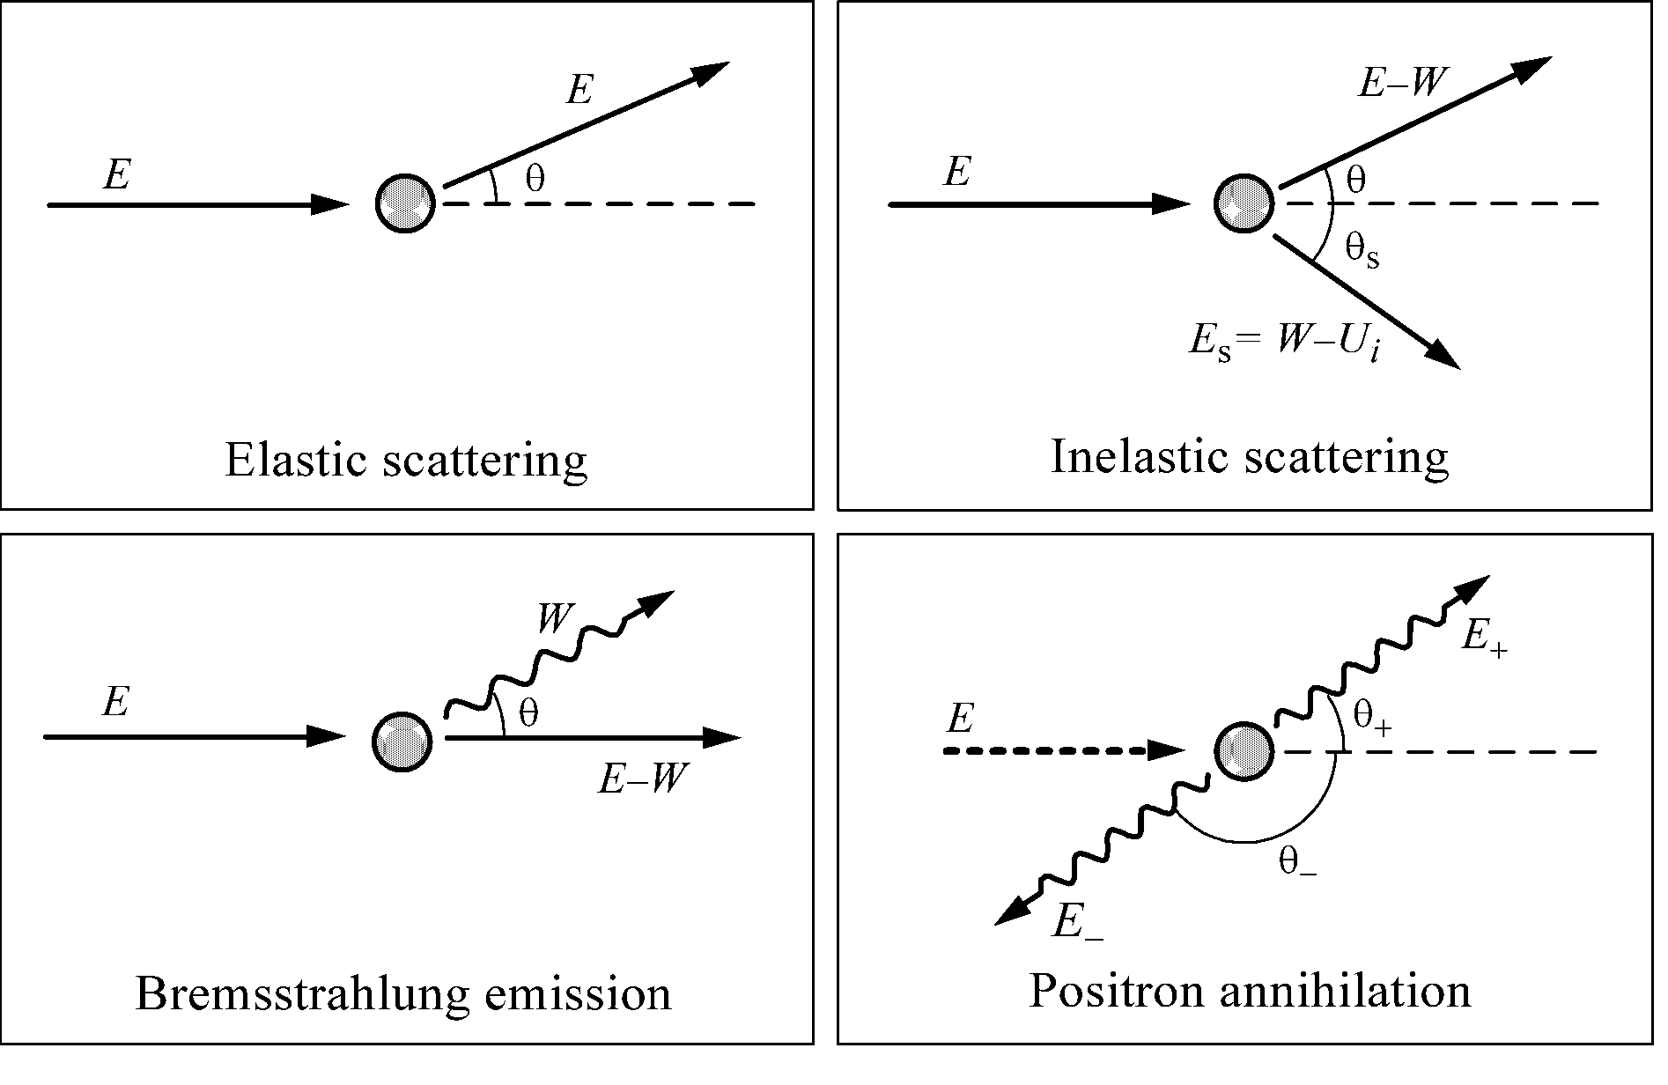
Electron and positron interactions (both)
– Bremsstrahlung
– Positron annihilation
– Multiple scattering
– Møller (e−e−) and Bhabha (e+e−) scattering.
– Continuous energy loss applied to charged particle tracks between discrete (hard) interactions.

Slide 37
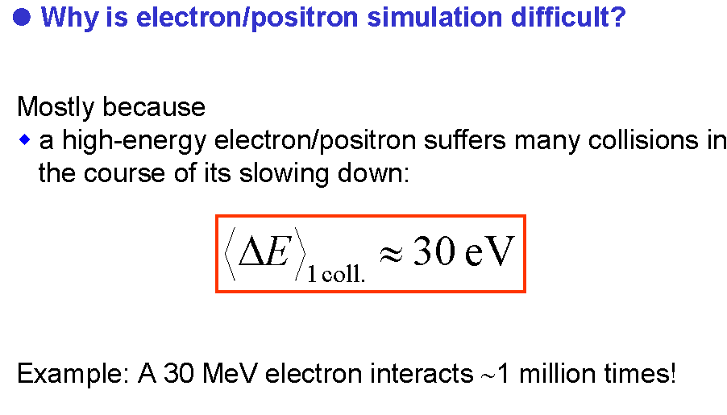

Slide 38
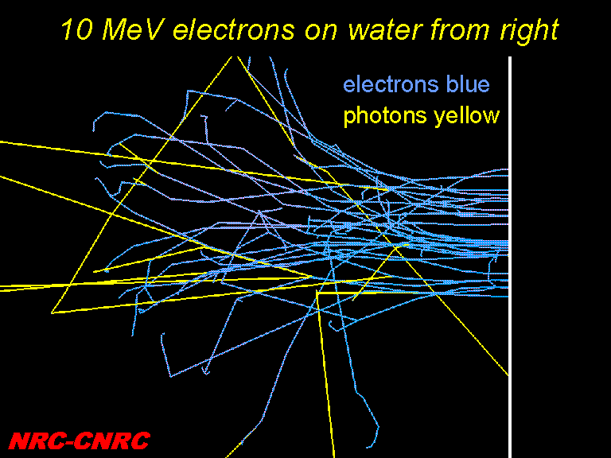
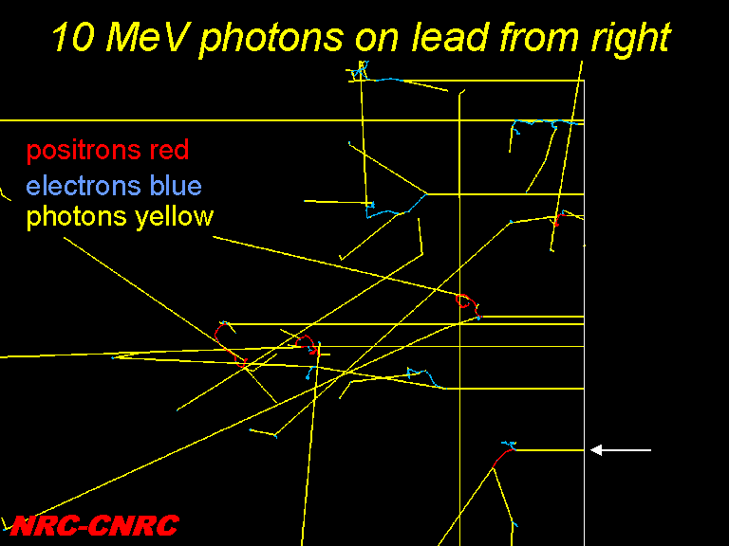
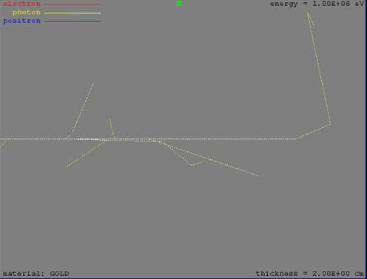
EGSnrc
Penelope

Slide 39
Some detailes on electron and positron interactions
(eg PENELOPE)
The simulation of electron and positron transport is performed by means of a mixed procedure (Class II CH).
Hard interactions, with scattering angle θ or energy loss W greater than preselected cutoff values θ_{c} and W_{c} (W_{cc} and W_{cr}), are simulated in detail.
θc is a (small) cutoff angle
Hard collisions: with θ > θc
few in each electron history detailed simulation is unexpensive
Soft collisions: with θ <θc
A large number (on average) between each pair of hard interactions

Slide 40
Soft interactions, with scattering angle or energy loss less than the corresponding cutoffs, are described by means of multiple-scattering approaches.
This simulation scheme handles lateral displacements and interface crossing appropriately and provides a consistent description of energy straggling.
The random-hinge method
The simulation is fairly stable under variations of the cutoffs θ_{c}, W_{cc} and W_{cr} and these can be made quite large, thus speeding up the calculation considerably, without altering the results.

Slide 41
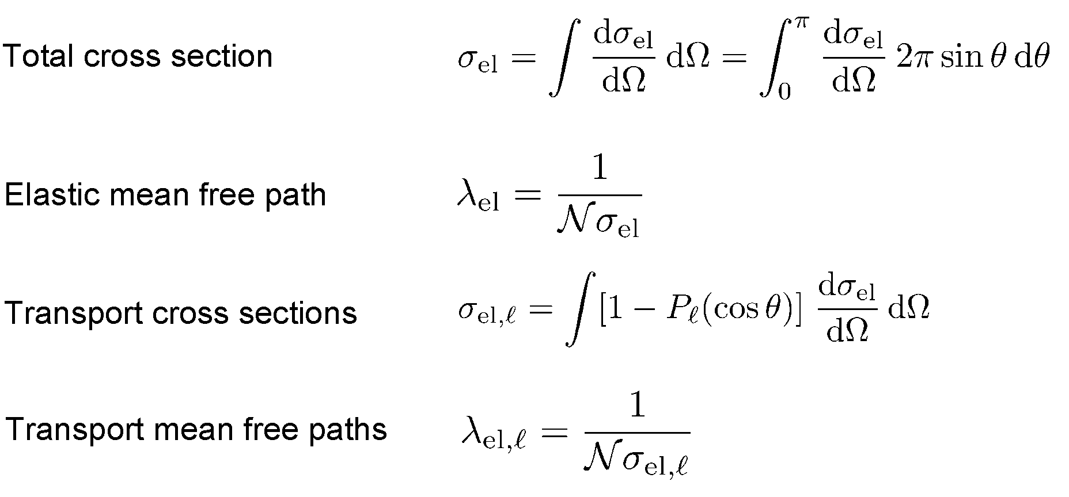

Slide 42
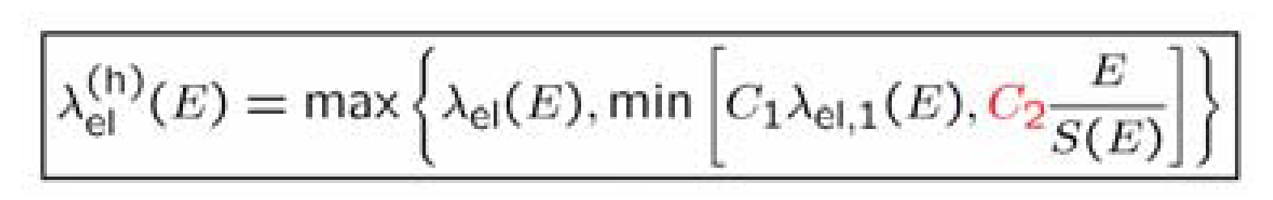
PENELOPE ALGORITM
for combined scattering and energy loss
C1(M): Average angular deflection, C₁ = 1- <cosθ>, produced by multiple elastic scattering along a path length equal to the mean free path between consecutive hard elastic events.
C2(M): Maximum average fractional energy loss, C₂, between consecutive hard elastic events

Slide 43
EGSnrc algoritm for electron trasport
Boundary crossing algorithm (BCA)
- used to transport electrons across region boundaries
- EXACT and PRESTA-I. The default is EXACT
In the EXACT case, electrons are transported in single elastic scattering mode as soon as they are within a distance from the boundary given by the EGSnrc input Skin depth for BCA
Skin depth for BCA
-If Boundary crossing algorithm= EXACT, then Skin depth for BCA determines the perpendicular distance (in elastic mean free paths) to the region boundary at which electron transport will go into single elastic scattering mode. A skin depth of 3 elastic mean free paths has been found to give peak efficiency in this case and is the default.
-If Boundary crossing algorithm= EXACT and Skin depth for BCA is set to a very large number (eg 1e10), then the entire simulation will be done in single scattering mode.
Electron-step algorithm
-determines the algorithm used to calculate lateral and longitudinal corrections to account for elastic scattering in a condensed history electron step
- PRESTA-I it is not recommended for low energy applications
- PRESTA-II (new and more accurate - the default)

Slide 44
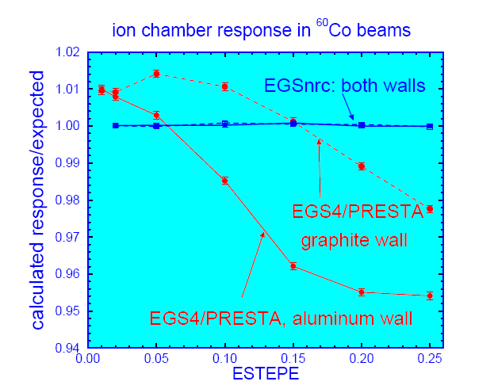
First page of EGSnrc user manual: Technical Report PIRS–701 (2009)

Slide 45
the simulation parameters of EGSnrc
ECUT– defines the global electron cutoff energy (in MeV)
the default is 0,521 MeV
PCUT–defines the global photon cutoff energy (in MeV)
the default is 0,01 MeV
SMAX– defines the maximum electron step length (in cm)
ESTEPE– the maximum fractional energy loss per electron step
For accurate electron transport with default EGSnrc electron step algorithm, ESTEPE should not exceed 0.25 (the default)

Slide 46
the simulation parameters of PENELOPE
selected by the user for each material
E_{abs} R(Eabs) -residual range- < typical dimensions of volume bins
C1~ 0.05 ; C2 ~ 0.05 (effective only at very high energies)
W_{cc} Cutoff energy loss for hard inelastic collisions < Eabs and energy resolution
W_{cr} Cutoff energy loss for hard bremsstrahlung emission < Eabs and energy resolution
s_{max} (to ensure multiple soft interactions, to allow energy-loss corrections)
~ 1/10 of the characteristic thickness of the body where the particle moves

Slide 47
Estimation of errors
(Both)
history by history method
  ∀ indipendent N histories scoring the quantity x (eg dose)
  a. estimate of mean value
  b. estimate of the variance
  c. estimate the mean error

Slide 48
Variance Reduction Techniques
(Both)
RANGE REJECTION
PHOTON FORCING
BREM SPLITTING
RUSSIAN ROULETTE
…..

Slide 49
APPLICATION in MEDICAL PHYSICS
A minimal sample pooling from literature

Slide 50
Monte Carlo and detectors
“ the EXIT DOSIMETRY”
Chytyk and McCurdy Med Phys 2009; Comprehensive fluence model for absolute portal dose image prediction
Yeo et al PMB 2009: Dose reconstruction for intensity-modulated radiation therapy using a non-iterative method and portal dose image
Lin et al Med Phys 2009: Measurement-based Monte Carlo dose calculation system for IMRT pretreatment and on-line transit dose verifications.
Kairn et al PMB 2008: Radiotherapy treatment verification using radiological thickness measured with an amorphous silicon electronic portal imaging device: Monte Carlo simulation and experiment.
Van Elmpt et al Radiother Oncol 2008: The next step in patient-specific QA: 3D dose verification of conformal and intensity-modulated RT based on EPID dosimetry and Monte Carlo dose calculations
Spezi e Lewis PMB 2002: Full forward Monte Carlo calculation of portal dose from MLC collimated treatment beams.

Slide 51
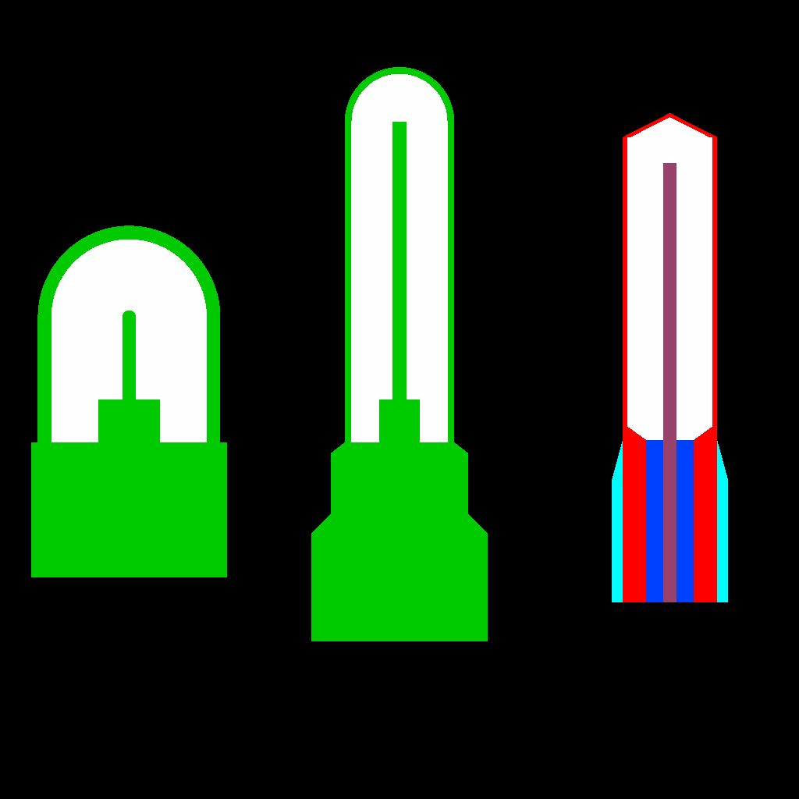
APPLICATION in MEDICAL PHYSICS
The ion chamber odyssey
Rogers in Fifty years of Monte Carlo simulation for medical physics PMB 2006
KERMA
in air K_{air}
to calculate the correction factor
K_{wall}
plays a
fundamental role in establishing primary standards for air kerma

Slide 52
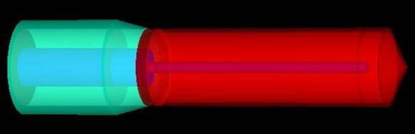

The ion chamber odyssey
Stopping-power
Ionizzation chamber
Correction to the paper of Nath and Schulz

Slide 53
The ion chamber odissey
…goes on
“there was a reticence by the world’s primary standards laboratories to give up their old approaches. It was not until further irrefutable experimental evidence was made available that there was a general change over to using Monte Carlo calculated correction factors”
Rogers PMB 2006

Slide 54
But the odissey become a challenge between codes!!
Sempau et al PMB 2004: Electron beam quality correction factors for plane-parallel ionization chambers: Monte Carlo calculations using the PENELOPE system.
Poon et al PMB 2005: Consistency test of the electron transport algorithm in the GEANT4 Monte Carlo code
Buckley e Rogers Med Phys 2006: Wall correction factors, Pwall, for parallel-plate ionization chamber.
Sempau e Andreo PMB 2006: Configuration of the electron transport algorithm of PENELOPE to simulate ion chambers.

Slide 55

Nowadays

Slide 56
Ion chamber, detectors, beams and ….
BEAMnrc/EGSnrc
Crop et al PMB 2009: The influence of small field sizes, penumbra, spot size and measurement depth on perturbation factors for microionization chambers
Francescon et al Med Phys 2008: Total scatter factors of small beams: A multidetector and Monte Carlo study
Downes et al Med Phys. 2009: Monte Carlo simulation and patient dosimetry for a kilovoltage cone-beam CT unit.
PENELOPE
Panettieri et al PMB 2008: Chamber-quality factors in 60Co for three plane-parallel chambers for the dosimetry of electrons, protons and heavier charged particles: PENELOPE Monte Carlo simulations
Rodriguez PMB 2008: PENLINAC: extending the capabilities of the Monte Carlo code PENELOPE for the simulation of therapeutic beams
Baumgartener et al Appl Radiat Isot 2009: Simulation of photon energy spectra from Varian 2100C and 2300C/D Linacs: simplified estimates with PENELOPE Monte Carlo models
Faddegon BA, Kawrakow I, Kubyshin Y, Perl J, Sempau J, Urban L
The accuracy of EGSnrc, Geant4 and PENELOPE Monte Carlo systems for the simulation of electron scatter in external beam radiotherapy
Phys Med Biol. 2009 Oct 21;54(20)

Slide 57
Monte Carlo Treatment Planning for Radiotherapy
Dose calculation algorithms based on the Monte Carlo method are widely regarded as the most accurate tool available in radiotherapy
Chetty et al Med Phys 2007:
Report of the AAPM TG105: issue associated with clinical implemetazion of Monte Carlo-based photon and electron beam treatment planning

Slide 58
Monte Carlo Treatment Planning for Radiotherapy
Although it is foreseeable that newer MC codes will allow one to simulate both radiation transport through the linac and dose delivered to the patient in one fast simulation ..... (Spezi and Lewis Radiat. Prot. Dos. 2008)
Until now a common approach has been to split calculations into two parts:
patient-independent
Source simulation
patient-dependent
Patient simulation

Slide 59
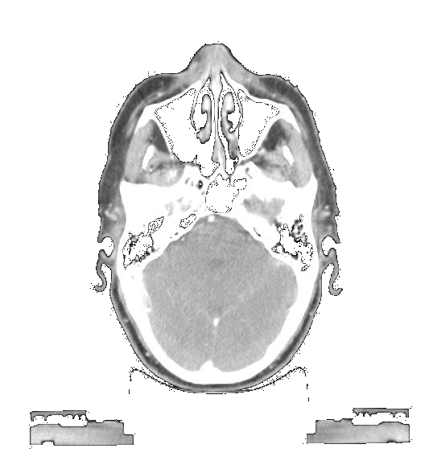
The simulation process for RT
target
primary
collimator
vacuum window
patient-independent
Components
LINAC-UP
flattening filter
ion chamber
phase space plane 1
jaws
phase space:
position, energy, direction, type, ecc,
for each history
patient-dependent
Structures
LINAC-DOWN
MLC
phase space plane 2
From TG105 AAPM

Slide 60
dedicated codes!!
PEREGRINE
VMC/XVMC/VMC++ (Voxel Monte Carlo) (MASTERPLAN e MONACO)
DPM (Dose Planning Method) e MCDOSE
Hartmann Siantar et al Med Phys 2001: Description and dosimetric verification of the PEREGRINE Monte Carlo dose calculation system for photon beams incident on a water phantom
Heath et al Med Phys 2004: Dosimetric evaluation of the clinical implementation of the first commercial IMRT Monte Carlo treatment planning system at 6 MV
Kawrakow e Fippel PMB 2000: Investigation of variance reduction techniques for MonteCarlo photon dose calculation using XVMC
Kawrakow Proc. MC2000 Meeting (Lisbona Berlin:Springer) 2001: VMC++, electron and photon Monte Carlo calculations optimized for radiation treatment planning
Cygler et al Med Phys 2004: Evaluation of the first commercial Monte Carlo dose calculation engine for electron beam treatment planning
Sempau et al PMB 2000: DPM, a fast, accurate Monte Carlo code optimized for photon and electron radiotherapy treatment planning dose
Ma et al PMB 2002: A Monte Carlo dose calculation tool for radiotherapy treatment planning

Slide 61
AAA vs CC vs PB in Eclipse/MasterPlan vs Monte Carlo (VMC++)

Slide 62
Monte Carlo Treatment Planning for Radiotherapy
TOMOTHERAPY
PENELOPE
Sterpin et al J. Phys 2007: Monte Carlo simulation of the tomotherapy treatment unit in the static mode using MC HAMMER, a Monte Carlo tool dedicated to tomotherapy
Sterpin et al J. Phys 2008: Analitytical model of the binary multileaf collimator of tomotherapy for Monte Carlo simulations
Sterpin et al PMB 2009: Monte Carlo simulation of helical tomotherapy with PENELOPE
BEAMnrc/EGSnrc
Zhao et al Med. Phys 2008 Monte Carlo calculation of helical tomotherapy dose delivery
Zhao et al Med. Phys 2008 Monte Carlo evaluation of a treatment planning system for helical tomotherapy in an anthropomorphic heterogeneous phantom and for clinical treatment

Slide 63
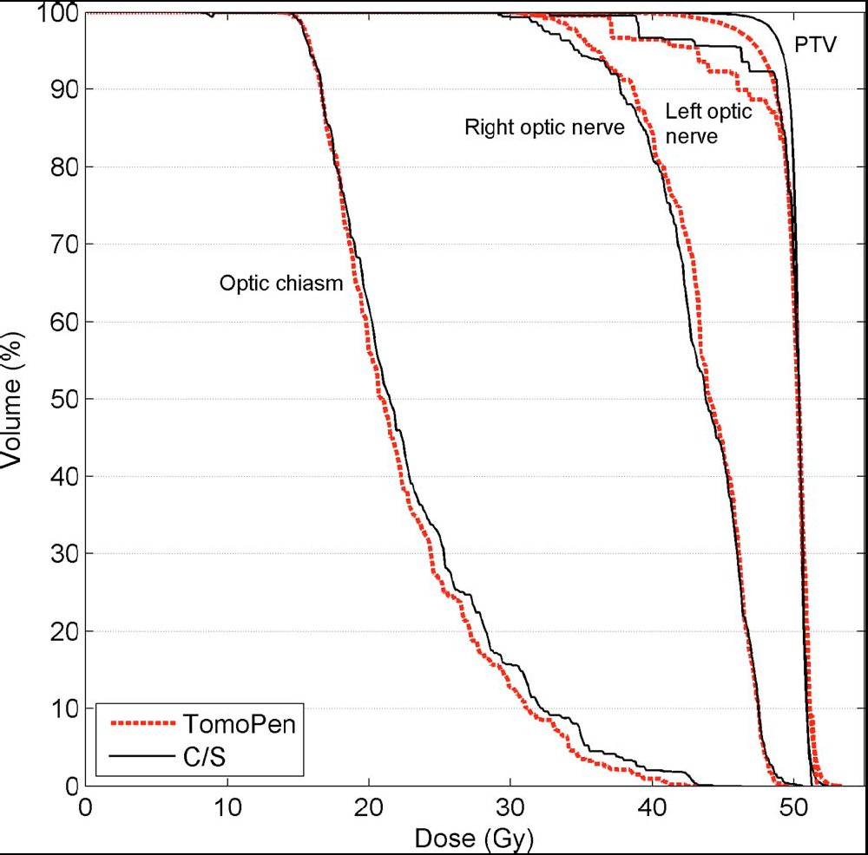
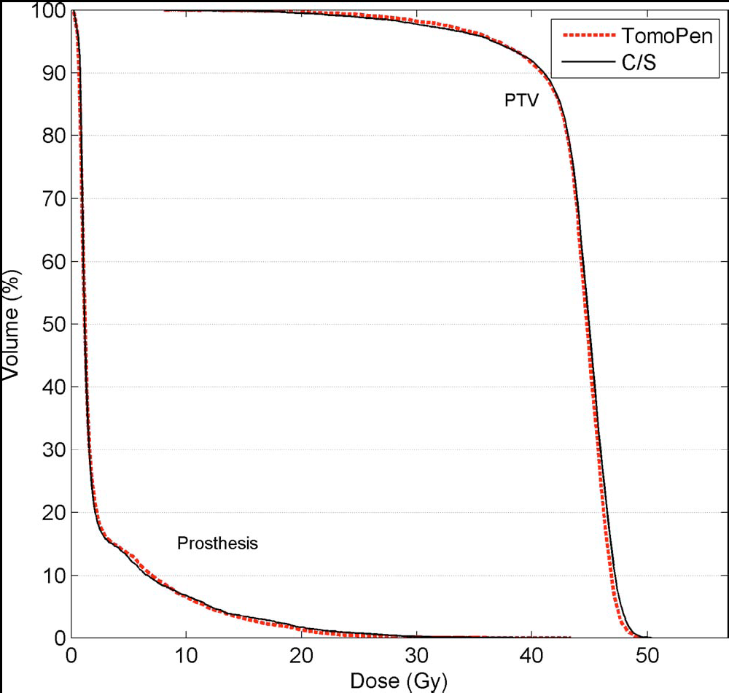
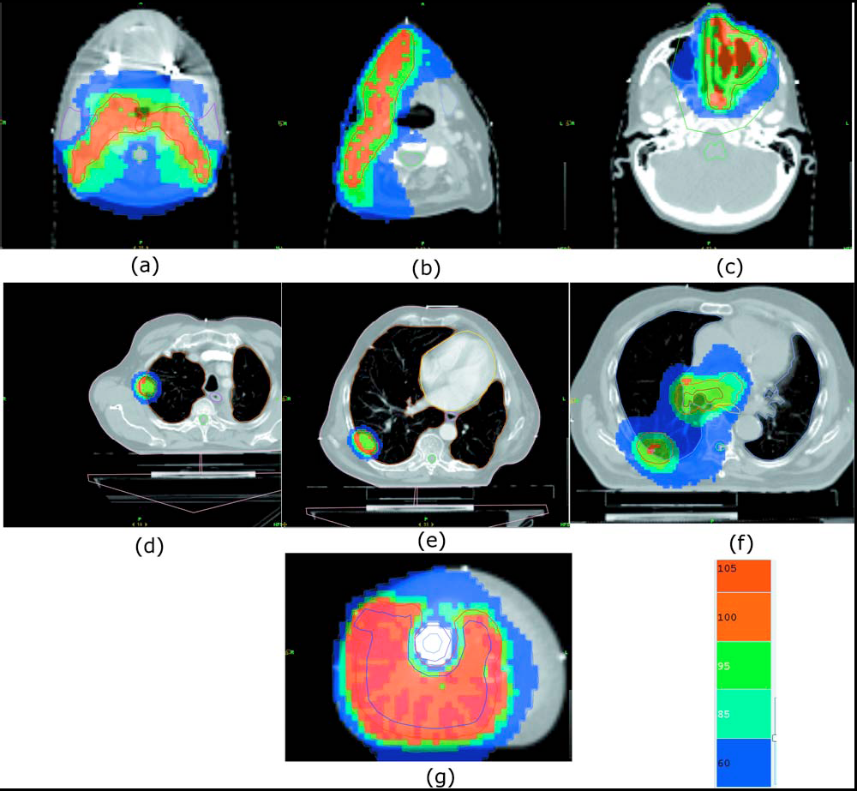
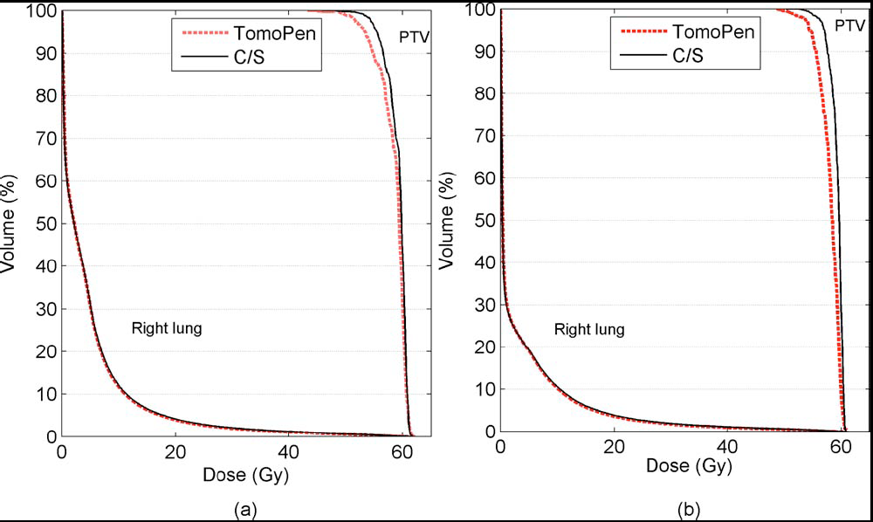
PENELOPE
Sterpin et al Med. Phys. 2009: Monte Carlo evaluation of the convolution/superposition algorithm of Hi-Art™ tomotherapy in heterogeneous phantoms and clinical cases

Slide 64
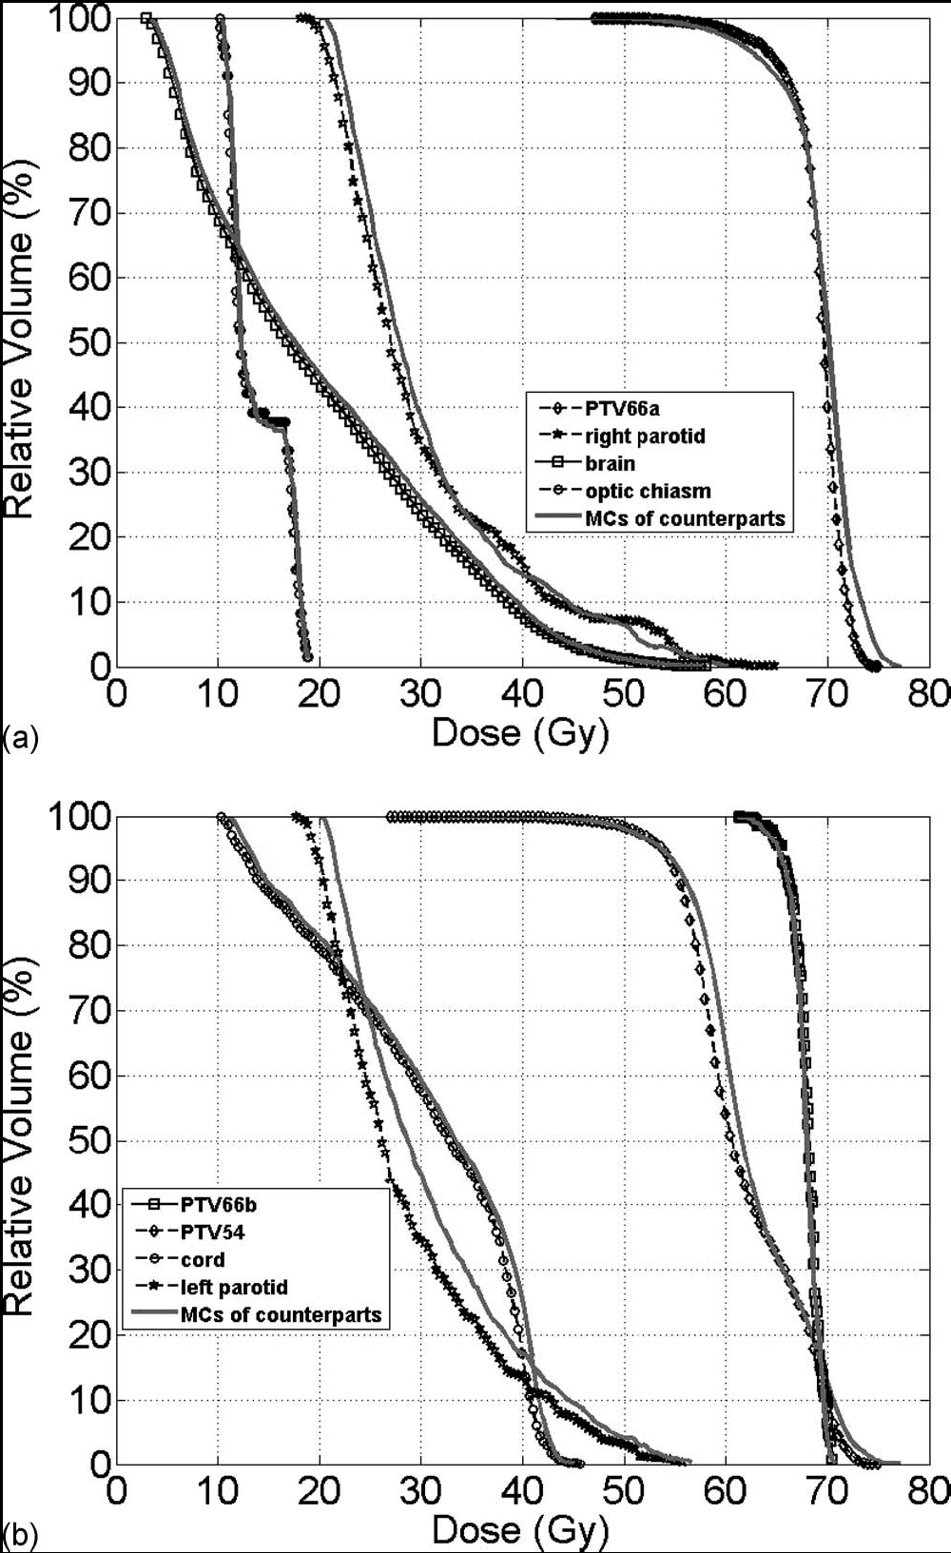
BEAMnrc/EGSnrc
Zhao et al Med. Phys 2008 Monte Carlo evaluation of a treatment planning system for helical tomotherapy in an anthropomorphic heterogeneous phantom and for clinical treatment

Slide 65
MC for patient dose calculation
We do not forget that the time for a Monte Carlo calculation does not depend on how many different beams are involved!!
So, especially for IMRT/TOMO/VMAT and 4DRT radiotherapy calculations, one day Monte Carlo techniques will be faster than the convolution–superposition algorithms for which the CPU time required is proportional to the number of beams involved!

Slide 66
The good solution
for MC patient dose calculation (?)

Slide 67
EGSnrc and PENELOPE
implemented the interface to read/write the IAEA format
Phase-space database for external beam radiotherapy
IAEA NAPC Nuclear Data Section
IAEA NAHU Dosimetry and Medical Radiation Physics Section
Project Officer: Roberto Capote
http://www-nds.iaea.org/phsp/phsp.htmlx
International Advisory Committee (IAC)
R. Jeraj
I. Kawrakow
C.-M. Ma
D.W.O. Rogers
F. Sanchez-Doblado
J. Sempau
J. Seuntjens
J.V. Siebers
P. Andreo

Slide 68
Objective: To build a database and disseminate representative phase-space data of accelerators and Co-60 units used in medical radiotherapy by compiling existing data that have been properly validated.
How to produce phase-space data:
The IAEA phsp format was designed to cover both phase-space files and event generators.
However, event generators are more difficult to produce; we should wait for improved Monte Carlo codes to be developed.
We have implemented the IAEA phsp format in a set of read/write routines .
We have also developed a converter from the frequently used EGSnrc phase-space file format to the IAEA phsp format .
A converter from ASCII phsp files to the IAEA phsp format is also available on request.
We expect that the IAEA phsp format will be implemented in major Monte Carlo codes during 2007; meanwhile we can use converters to produce phsp files for submission.
How to submit phase-space data:
Read carefully the INDC(NDS)-0484 technical report
Convert your phsp file to the IAEA format. You should obtain both the header and corresponding IAEA formatted phsp file
Upload the header and phsp files. Alternatively, you can upload the header, and send the DVD containing the phsp data by mail to the IAEA/NDS address.
How to download phase-space data: You have to select a phsp data type among Co-60 phsp, linac electron phsp or linac photon phsp. Alternatively, you can request an electronic copy of the phsp by sending an e-mail.

Slide 69
Phase-space database for external beam radiotherapy
Project Officer: Roberto Capote
List of photon PHSP data for linear accelerators
Name Last modified Size Description Parent Directory -
MC_correction_factors.pdf 17-Oct-2007 11:37 221K Adobe Acrobat document
SIEMENS_PRIMUS_6.0_0.5x0.5_0001.IAEAheader 18-Oct-2007 14:06 4.6K
SIEMENS_PRIMUS_6.0_0.5x0.5_0001.IAEAphsp 30-May-2007 16:26 2.1M
SIEMENS_PRIMUS_6.0_0.8x0.8_0001.IAEAheader 18-Oct-2007 14:06 4.7K
SIEMENS_PRIMUS_6.0_0.8x0.8_0001.IAEAphsp 30-May-2007 16:28 5.7M
SIEMENS_PRIMUS_6.0_1.0x1.0_0001.IAEAheader 18-Oct-2007 14:07 4.5K
SIEMENS_PRIMUS_6.0_1.0x1.0_0001.IAEAphsp 30-May-2007 16:30 9.1M
SIEMENS_PRIMUS_6.0_1.2x1.2_0001.IAEAheader 18-Oct-2007 14:07 4.5K
SIEMENS_PRIMUS_6.0_1.2x1.2_0001.IAEAphsp 30-May-2007 16:33 13M
SIEMENS_PRIMUS_6.0_1.5x1.5_0001.IAEAheader 18-Oct-2007 14:07 4.5K
SIEMENS_PRIMUS_6.0_1.5x1.5_0001.IAEAphsp 30-May-2007 16:37 20M
SIEMENS_PRIMUS_6.0_1.8x1.8_0001.IAEAheader 18-Oct-2007 14:08 4.6K
SIEMENS_PRIMUS_6.0_1.8x1.8_0001.IAEAphsp 30-May-2007 16:42 30M
SIEMENS_PRIMUS_6.0_2.0x2.0_0001.IAEAheader 18-Oct-2007 14:08 4.5K
SIEMENS_PRIMUS_6.0_2.0x2.0_0001.IAEAphsp 30-May-2007 16:49 38M
SIEMENS_PRIMUS_6.0_2.5x2.5_0001.IAEAheader 18-Oct-2007 14:08 4.5K
SIEMENS_PRIMUS_6.0_2.5x2.5_0001.IAEAphsp 30-May-2007 16:57 54M
SIEMENS_PRIMUS_6.0_3.0x3.0_0001.IAEAheader 18-Oct-2007 14:09 4.5K
SIEMENS_PRIMUS_6.0_3.0x3.0_0001.IAEAphsp 30-May-2007 17:10 86M
SIEMENS_PRIMUS_6.0_5.0x5.0_0001.IAEAheader 18-Oct-2007 14:11 4.5K
SIEMENS_PRIMUS_6.0_5.0x5.0_0001.IAEAphsp.gz 30-May-2007 17:40 168M GZIP compressed document SIEMENS_PRIMUS_6.0_10.0x10.0_0001.IAEAheader 18-Oct-2007 14:12 4.6K
SIEMENS_PRIMUS_6.0_10.0x10.0_0001.IAEAphsp.gz 30-May-2007 19:38 754M GZIP compressed document SIEMENS_PRIMUS_6.0_15.0x15.0_0001.IAEAheader 18-Oct-2007 14:12 4.6K
SIEMENS_PRIMUS_6.0_15.0x15.0_0001.IAEAphsp.gz 31-May-2007 11:47 162M GZIP compressed document SIEMENS_PRIMUS_6.0_20.0x20.0_0001.IAEAheader 18-Oct-2007 14:12 3.6K
SIEMENS_PRIMUS_6.0_20.0x20.0_0001.IAEAphsp.gz 31-May-2007 13:29 705M GZIP compressed document

Slide 70
Conclusion
There is not a real “conclusion”, just a lot of work to do...........

Slide 71
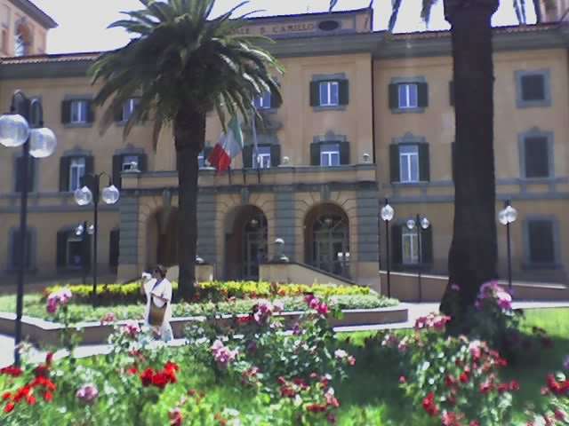
The medical physics involved at San Camillo Forlanini
in Monte Carlo clinical application
Danilo Aragno
Margherita Betti
Massimiliano Pacilio
Maria Cristina Pressello
Roberta Rauco
Students of Specialization School in Medical Physics
Paola Grimaldi
Antonella Stravato
Thanks for your attention

